Slide 1

SANJEEVANI
By: Team apollo

Slide 2
Introduction
Sanjeevani is a web application thought to construct emergency health services in Nepal. This platform connects users with vital health information about individuals, offering a reliable and user-friendly solution for managing health emergencies. With its focus on accessibility and effectiveness, Sanjeevani aims to bridge the gap in emergency response and provide timely support to those in need..

Slide 3




Our Team
Avishek Niraula
Gaurav Shah
Niraj Bista
Aadesh Dahal

Slide 4
Problem Statement
Problem 01
Problem 02
Problem 03
Delayed Response
Limited acessibilitY
Poor Health
Data Management

Slide 5
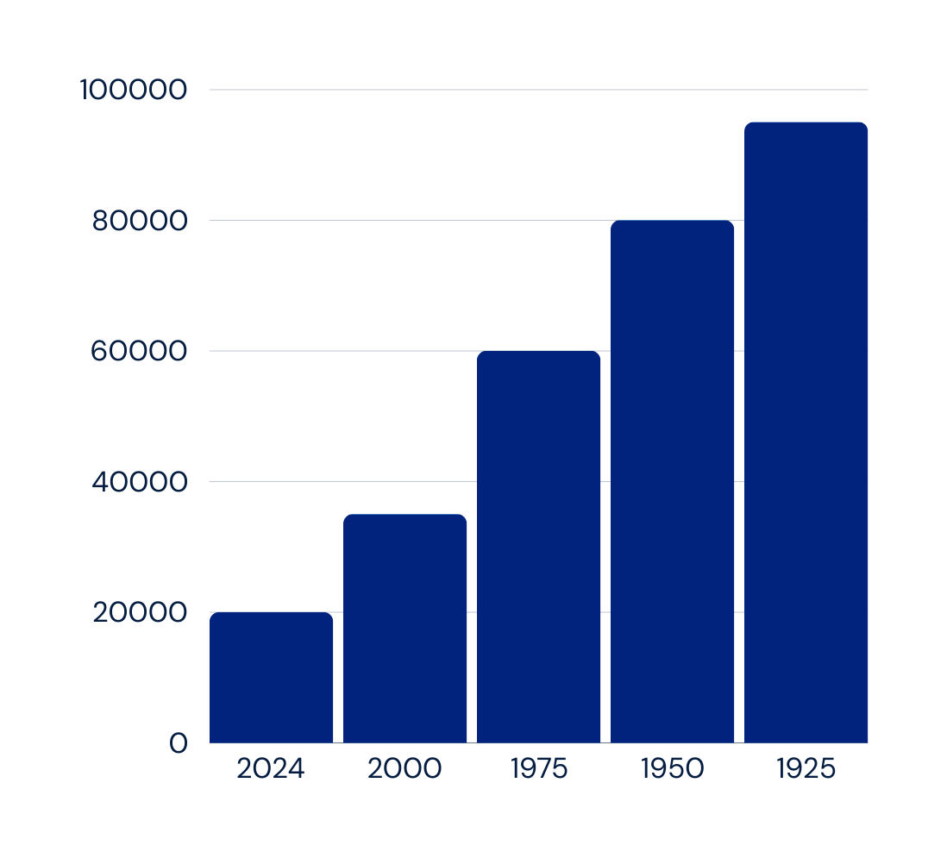
Statistics
number of deaths
years
No of deaths per 25 years due to lack of emergency services according to WHO

Slide 6
Solution Statement
Objective 01
Objective 02
Objective 03
Provide real-time health information to assist in emergencies..
Bridge the gap in healthcare accessibility, especially in remote areas.
Simplify and streamline communication between users and emergency services.

Slide 7

Emergency SOS Service
01
02
Proximity Alerts
SOLUTIONS
03
connectivity
04
Pre-Saved Emergency
Contacts

Slide 8



Business Model
Subscription Plans
As a tailored application
Government and NGO Funding

Slide 9



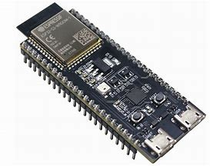

Tech Used
MQTT
FLASK
MQTTX
ESP32
TWILIO
MOSQUITTO

Slide 10






SCALABLITY
SERVICE 01
SERVICE 03
Emergency Response
Rural Outreach
SERVICE 02
SERVICE 04
Disaster Management
Healthcare Accessibility

Slide 11

SCALABILITY
01
02
03
04
Scalable Communic-ation Channels
Subscription model
Microservice Architecture
Partnerships

Slide 12


PROBLEMS ENCOUNTERED
Lack of resources
Time
Technical isssues

Slide 13


THANK YOU!
www.sanjeevani.com

